Slide 1

FPGA-BASED DESIGN AND IMPLEMENTATION OF AN (8:2) COMPRESSOR FOR OPTIMIZED 16X16 MULTIPLICATION
Mentor :
Dr. S Aditya
Assistant Professor
Dept of ECE
SRMIST
Presented By :
Krithika M
Suba Lakshmi R

Slide 2
INTRODUCTION
1
Optimizing power and performance in real time computing.
Efficient multipliers reduce hardware complexity.
Compressors improve delay, power and area.
Hierarchical (8:2) compression enhances speed.
Validated through FPGA and simulations.

Slide 3
PROBLEM STATEMENT
2
Real-time applications demand high-speed, low-power multipliers.
Conventional multiplier architectures suffer from high latency and significant power consumption due to large partial product trees.
Reducing hardware complexity while maintaining computational accuracy is a key challenge.

Slide 4
LITERATURE SURVEY
3
Paper Title | Ref. No. | Year Published | Methodology Proposed | Key Innovation
Banisharif Dehkordi, M., & Ahmadifar, H. (2024). A new approximate (8; 2) compressor for image processing applications. IETE Journal of Research, 70(2), 1352-1360. | [1] | 2024 | Approximate (8:2) compressor in a 16×16 multiplier | Achieved 5% delay reduction, 17% area savings, and 8% improvement in (PDP)
Han, J., & Orshansky, M. (2013, May). Approximate computing: An emerging paradigm for energy-efficient design. In 2013 18th IEEE European Test Symposium (ETS) (pp. 1-6). IEEE. | [5] | 2013 | Approximate multiplier | Offers energy-efficient and fault-tolerant design
Savio, M. M. D., & Deepa, T. (2020, July). Design of higher order multiplier with approximate compressor. In 2020 IEEE international conference on electronics, computing and communication technologies (CONECCT) (pp. 1-6). IEEE. | [7] | 2020 | (8:2) compressor applied in a 16×16 multiplier | Improved performance efficiency without significantly affecting the error margin
Akshay, K. P., Jagadeeshkumar, N., Barusu, M. R., & Meganathan, D. (2023, December). Approximate Compressor for Efficient Multiplication in Image Processing Applications. In 2023 International Conference on Next Generation Electronics (NEleX) (pp. 1-6). IEEE. | [8] | 2023 | (8:2) compressor using hierarchical configurations | A combination of (5:2), (4:2), and (3:2) compressors to optimize delay, power, and area

Slide 5
4
LITERATURE GAP
1
Accuracy vs hardware efficiency trade-off is not well-balanced.
2
Limited hybrid compressor exploration in (8:2) designs.
3
Lack of FPGA-based real-world validation.
4
Hardware-aware optimization needs more focus.
5
Scalable (8:2) architecture for FPGA is needed.

Slide 6
5
MOTIVATION BEHIND
Fast, power-efficient multipliers for AI and image processing.
Efficient designs to reduce power and area
Optimal compressor designs for FPGA multipliers.
Scalable multipliers for real-time FPGA testing.
FPGA-validated (8:2) compressor for power and speed

Slide 7
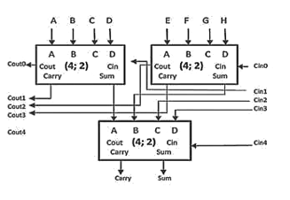
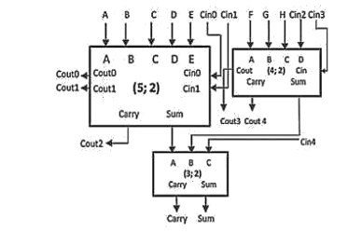
EXISTING HIERARCHICAL ARCHITECTURE
6
Figure 1: Hierarchical (8:2) compressors [9]

Slide 8
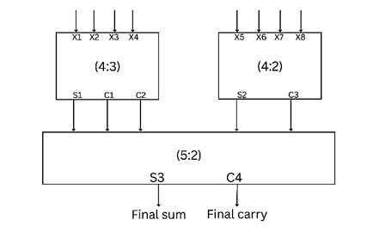
7
PROPOSED ARCHITECTURE
The proposed (8:2) compressor uses a hierarchical design with (4:2), (4:3) and a (5:2) compressor.
The compressor is integrated into both 8×8 and 16×16 multipliers

Slide 9
PROPOSED ARCHITECTURE
8
FPGA implementation is performed on the Artix-7 board for real-time verification of the 8×8 multiplier, while extensive simulations are conducted for the 16×16 multiplier.
The design is validated for power and area efficiency, ensuring low-power and high-speed arithmetic computation.
Through hardware synthesis and simulation-based verification, the proposed compressor is demonstrated as a feasible solution for next-generation multipliers in real-time computing platforms.

Slide 10
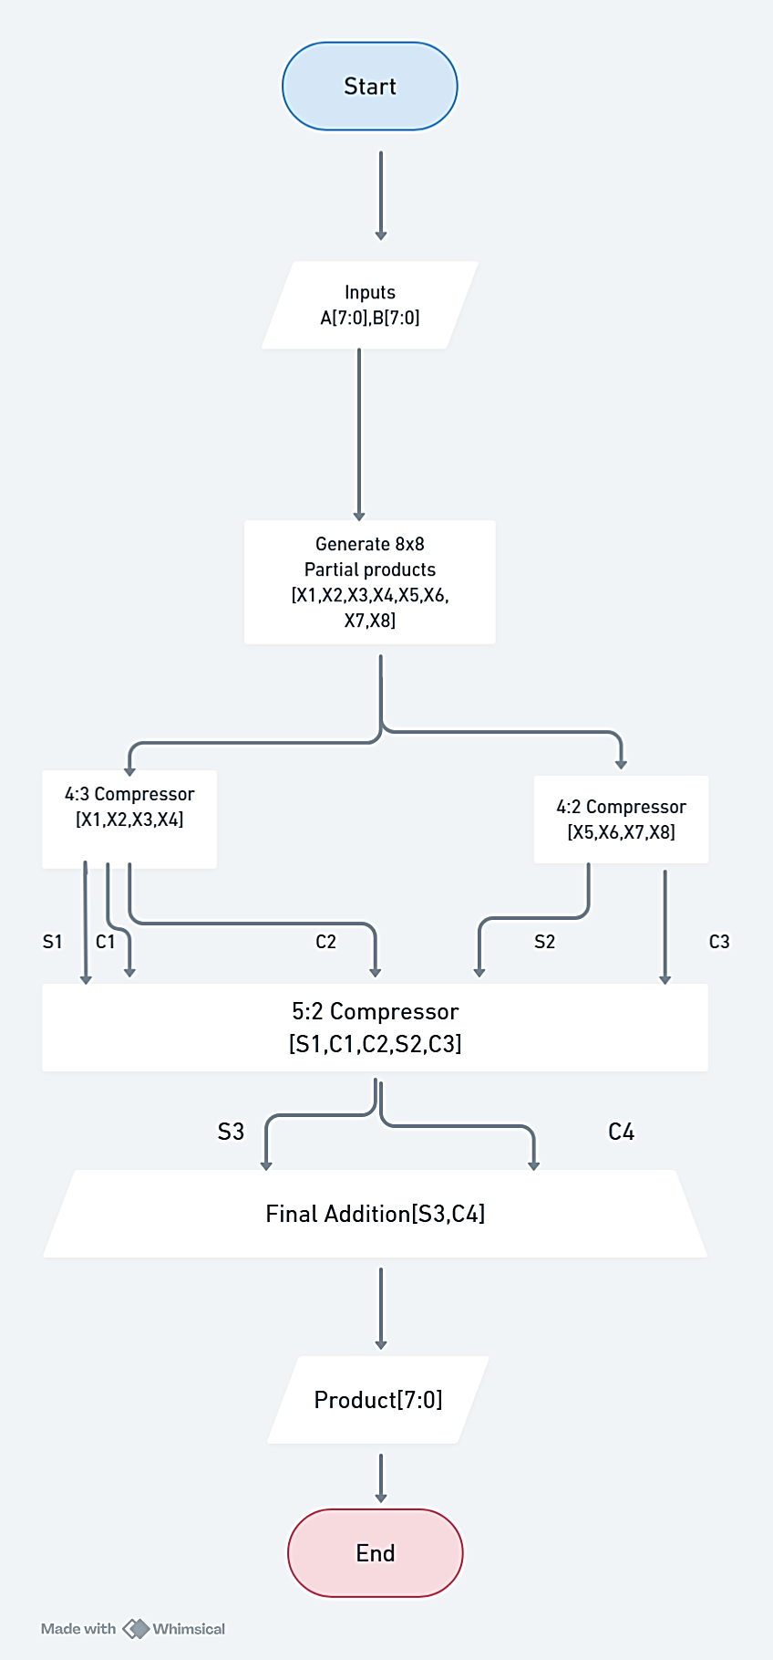
FLOWCHART
9

Slide 11
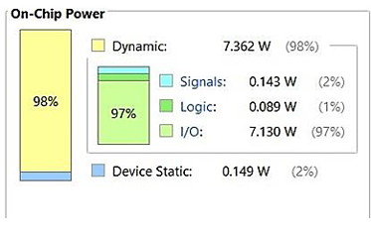
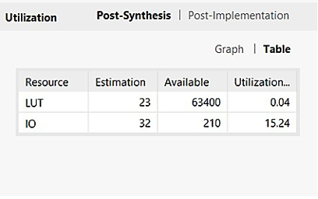
RESULT ANALYSIS
10
Figure 1 : Power Analysis of 8x8 proposed approximate multiplier.
Figure 2: Utilization of 8x8 proposed approximate multiplier.

Slide 12
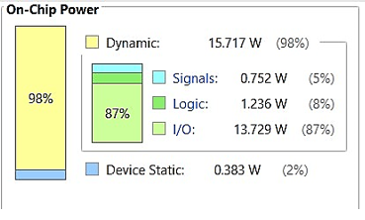
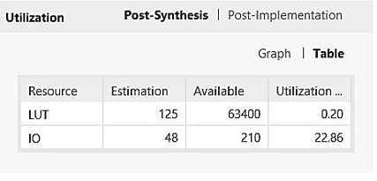
11
RESULT ANALYSIS
Figure 3: Power Analysis of 16x16 proposed approximate multiplier
Figure 4: Utilization of 16x16 proposed approximate multiplier.

Slide 13
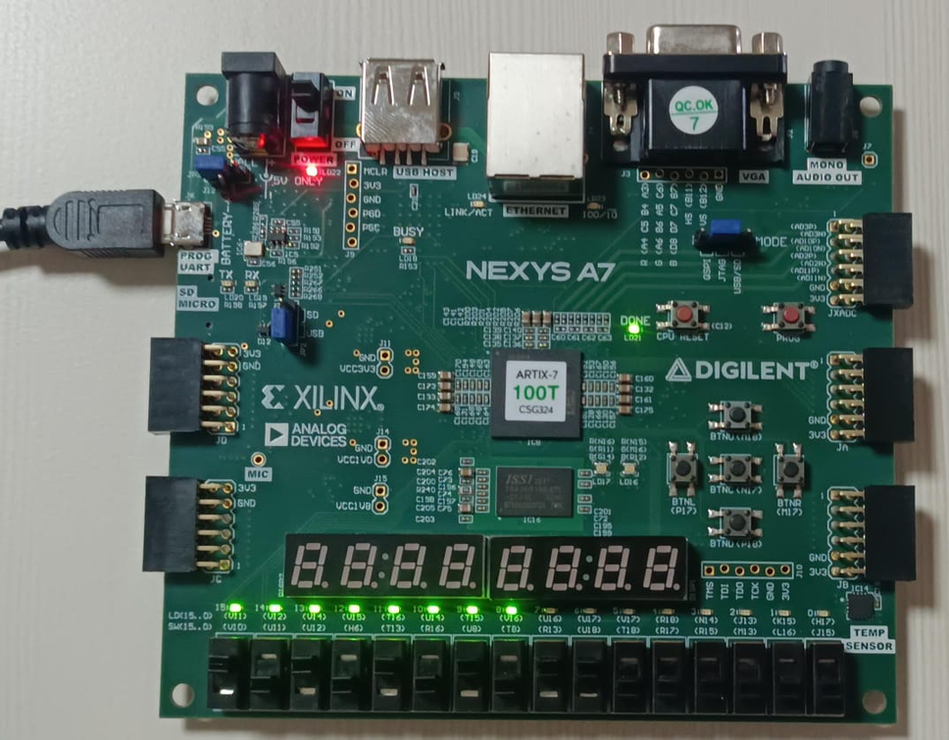
12
FPGA IMPLEMENTATION

Slide 14
13
TESTCASES
A – INPUT (8-BITS) | B – INPUT(8-BITS) | PRODUCT
00000010(2) | 00000010(2) | 0000000000000100(4)
00001000(8) | 00000100(4) | 0000000000100000(32)
00001111(15) | 00001111(15) | 0000000011100001(225)
00100000(32) | 00000010(2) | 0000000100000000(64)
11111111(255) | 11111111(255) | 1111111000000001(65025)

Slide 15
14
ERROR PERCENTAGE
Given Inputs:
A = 255 B=255
Exact Product: 65025 - 1111111000000001
Approximate Output: 56449 - 1101110010000001
Error Calculation:
1. Error (Absolute Difference): ∣65025−56449∣=8576
2. Error Percentage: Error %=(8576/65025​)×100≈13.18%

Slide 16
15
CONCLUSION
The (8:2) compressor-based multiplier enhances speed, power efficiency, and resource utilization.
The design effectively balances accuracy and complexity, making it ideal for various applications
FPGA implementation of the 8×8 multiplier validates its practical feasibility, while simulation results confirm the scalability of the 16×16 multiplier.
Adaptive approximate computing techniques can be explored to further optimize the accuracy-power trade-off.

Slide 17
REFERENCES
16
1. Banisharif Dehkordi, M., & Ahmadifar, H. (2024). A new approximate (8; 2) compressor for image processing applications. IETE Journal of Research, 70(2), 1352-1360.
2.Chippa, V. K., Chakradhar, S. T., Roy, K., & Raghunathan, A. (2013, May). Analysis and characterization of inherent application resilience for approximate computing. In Proceedings of the 50th Annual Design Automation Conference (pp. 1-9).
3.Silveira, B., Paim, G., Abreu, B., Grellert, M., Diniz, C. M., da Costa, E. A. C., & Bampi, S. (2017). Power-efficient sum of absolute differences hardware architecture using adder compressors for integer motion estimation design. IEEE Transactions on Circuits and Systems I: Regular Papers, 64(12), 3126-3137
4. Gupta, V., Mohapatra, D., Park, S. P., Raghunathan, A., & Roy, K. (2011, August). IMPACT: IMPrecise adders for low-power approximate computing. In IEEE/ACM International Symposium on Low Power Electronics and Design (pp. 409-414). IEEE.
5.Han, J., & Orshansky, M. (2013, May). Approximate computing: An emerging paradigm for energy-efficient design. In 2013 18th IEEE European Test Symposium (ETS) (pp. 1-6). IEEE.

Slide 18
REFERENCES
17
6.Vasicek, Z., & Sekanina, L. (2014). Evolutionary approach to approximate digital circuits design. IEEE Transactions on Evolutionary Computation, 19(3), 432- 444.
7.Savio, M. M. D., & Deepa, T. (2020, July). Design of higher order multiplier with approximate compressor. In 2020 IEEE international conference on electronics, computing and communication technologies (CONECCT) (pp. 1-6). IEEE
8.Akshay, K. P., Jagadeeshkumar, N., Barusu, M. R., & Meganathan, D. (2023, December). Approximate Compressor for Efficient Multiplication in Image Processing Applications. In 2023 International Conference on Next Generation Electronics (NEleX) (pp. 1-6). IEEE.
9.Fontanari, T. V., Paim, G., Rocha, L. M., Ücker, P., Costa, E., & Bampi, S. (2020, February). An efficient N-bit 8-2 adder compressor with a constant internal carry propagation delay. In 2020 IEEE 11th Latin American Symposium on Circuits & Systems (LASCAS) (pp. 1-4). IEEE.
.
10.Kumar, A., Kumar, A., & Nand, D. (2021, May). Design and Study of Dadda Multiplier by using 4: 2 Compressors and Parallel Prefix Adders for VLSI Circuit Designs. In 2021 2nd International Conference for Emerging Technology (INCET) (pp. 1-5). IEEE.

Slide 19
THANK YOU !

